Slide 1
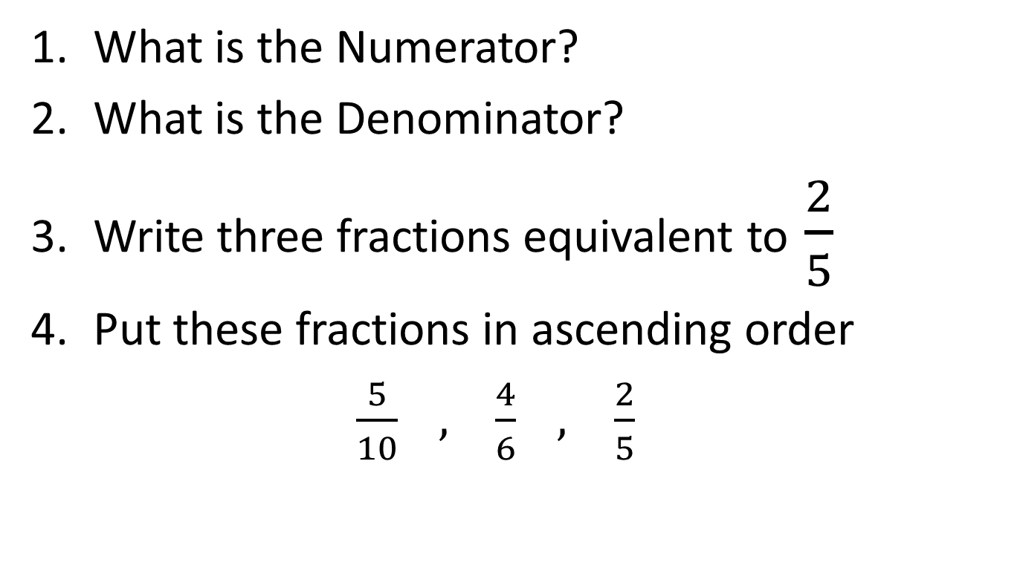
Fraction Mini Quiz
What is the Numerator?
What is the Denominator?
Write three fractions equivalent to $\frac{2}{5}$
Put these fractions in ascending order
$\frac{5}{10} , \frac{4}{6} , \frac{2}{5}$
Notes:
Hook
Complete in left hand side

Slide 2
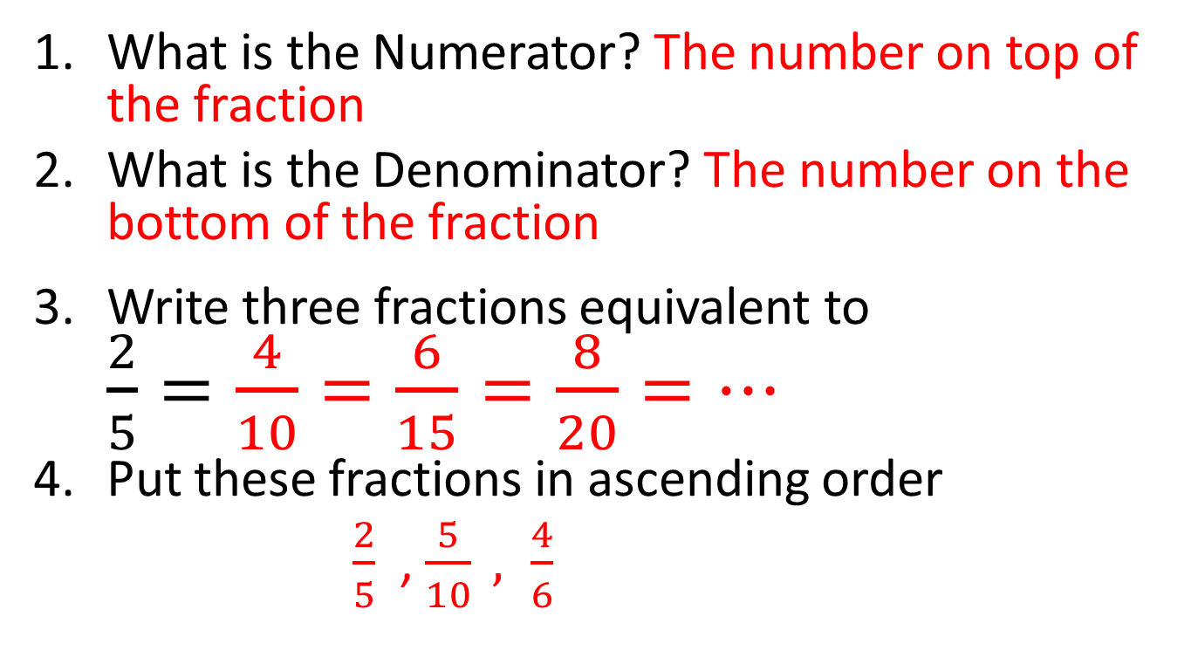
Answers
What is the Numerator? The number on top of the fraction
What is the Denominator? The number on the bottom of the fraction
Write three fractions equivalent to $\frac{2}{5}=\frac{4}{10}=\frac{6}{15}=\frac{8}{20}=…$
Put these fractions in ascending order
$\frac{2}{5}$ , $\frac{5}{10} , \frac{4}{6}$

Slide 3
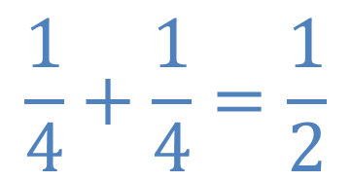
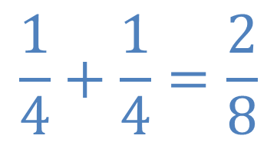
Which is correct?
$$\frac{1}{4}+\frac{1}{4}=\frac{2}{8}$$
$$\frac{1}{4}+\frac{1}{4}=\frac{1}{2}$$
or
Write down why you picked your answer

Slide 4
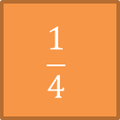

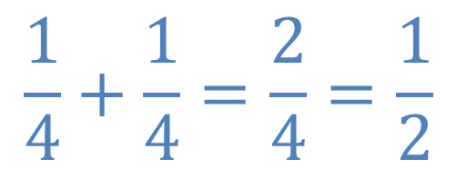




$$\frac{1}{4}$$
$$\frac{1}{4}$$
$$\frac{1}{4}$$
$$\frac{1}{4}$$
$$\frac{1}{4}$$
$$\frac{1}{4}$$
We start with one quarter and if we add another quarter we now have two quarters
$$\frac{1}{4}+\frac{1}{4}=\frac{2}{4}=\frac{1}{2}$$

Slide 5


Which is correct?
$$\frac{1}{4}+\frac{1}{4}=\frac{2}{8}$$
$$\frac{1}{4}+\frac{1}{4}=\frac{1}{2}$$
or

Slide 6
Lesson objective
By the end of this lesson you will be able to;
- Add and subtract fractions with like denominators
Notes:
Lesson

Slide 7
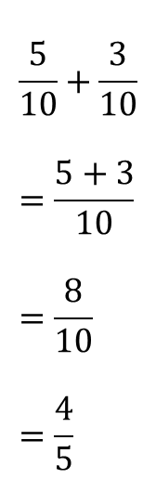
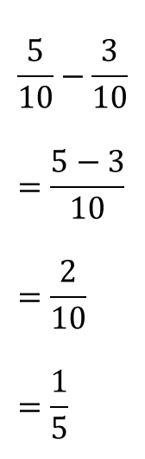
24
7
30
Date
Fractions
EQ – Describe how to add and subtract fractions with like denominators
When can you add and subtract fractions?
You can only add and subtract fractions when they have the same denominator.
When the denominator is the same add or subtract the numerators, then simplify your answer when possible.
$$\frac{5}{10}+\frac{3}{10} \\ =\frac{5+3}{10} \\ =\frac{8}{10} \\ =\frac{4}{5}$$
$$\frac{5}{10}−\frac{3}{10} \\ =\frac{5−3}{10} \\ =\frac{2}{10} \\ =\frac{1}{5}$$
Examples:
5
Notes:
Lesson objective (EQ)

Slide 8

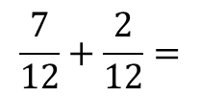
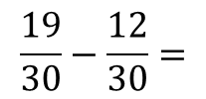
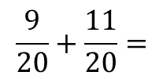
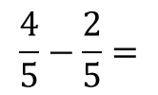
Try these
$$\frac{7}{12}+\frac{2}{12}=$$
$$\frac{9}{20}+\frac{11}{20}=$$
$$\frac{4}{5}−\frac{2}{5}=$$
$$\frac{19}{30}−\frac{12}{30}=$$
Notes:
Check for understanding/Guided practice

Slide 9

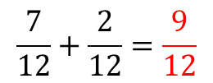
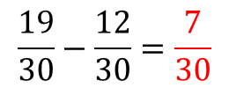
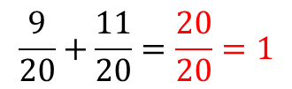
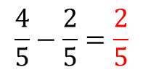
Answers
$$\frac{7}{12}+\frac{2}{12}=\frac{9}{12}$$
$$\frac{9}{20}+\frac{11}{20}=\frac{20}{20}=1$$
$$\frac{4}{5}−\frac{2}{5}=\frac{2}{5}$$
$$\frac{19}{30}−\frac{12}{30}=\frac{7}{30}$$
Notes:
Check for understanding

Slide 10
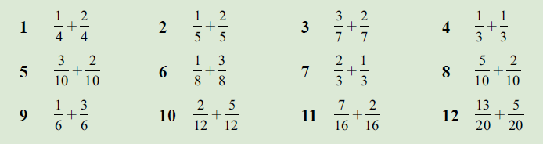
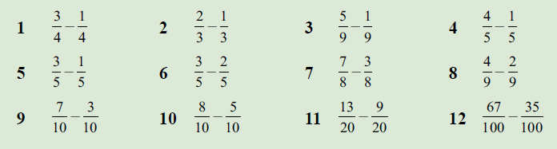
Practice
Adding
Subtracting
Notes:
Independent practice

Slide 11
Exit pass
Write your summary answering the EQ
“Describe how to add and subtract fractions with like denominators”
Notes:
Closure

